Slide 1
Noobs guide to stalki-
Uhh, I mean OSINT!
Kade Morton
Mozilla Regional Coordinator
kademorton@protonmail.com / @cypath

Slide 2

Who am I?

Slide 3

If Aaron Swartz is your jam

Slide 4

I was a noob...

Slide 5

...but then...

Slide 6

You can’t lose if you don’t boot a VM

Slide 7
So this dude is our mark
What we know
Name: Robert Winkel
Twitter handle: @RobertWinkel

Slide 8
Some interesting information...
Present at Kiwicon, flag!
He’s with Telstra, flag!
Let’s note down his mobile carrier for later...

Slide 9
That’s a windows operating system if you look at the top of the photo, too bad I cannot confirm the computer is his.
Buuuuut can confirm our mark is a member of the “Awkward Hugs Movement”, flag!

Slide 10
I have reason to believe this isn’t actually him, but he went to Platypuscon, flag!
Browser appears to be Firefox, flag!

Slide 11
Look real close, there’s a tattoo on his wrist. Now if we don’t see the mark’s face but we see the tattoo we know we have the mark

Slide 12
He likes Mr Robot, flag!
He uses Windows, and based on timestamp Aug 14, a Sunday, at 8:28pm, likely to be a home computer

Slide 13
Let’s file this away for later...

Slide 14
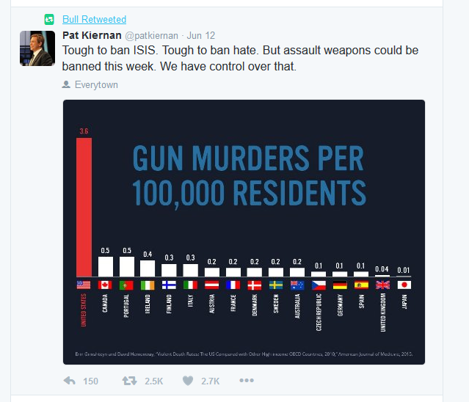
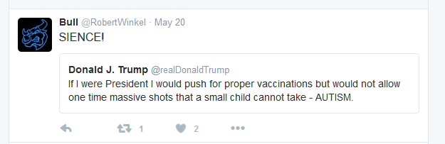
Probably supports gun control
Probably doesn’t like Donald Trump

Slide 15
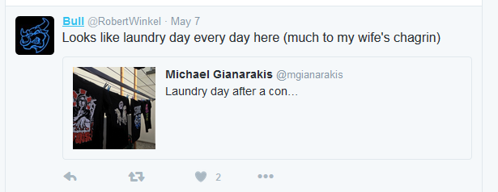
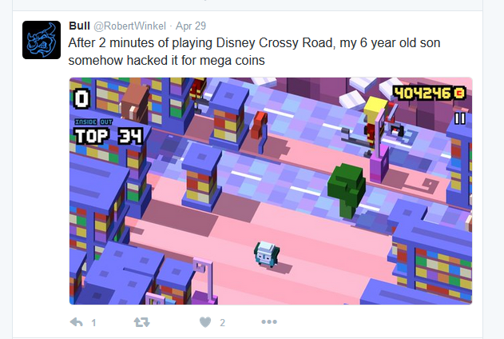
Has a wife, so married, flag!
Has a six year old son as of April 29th

Slide 16
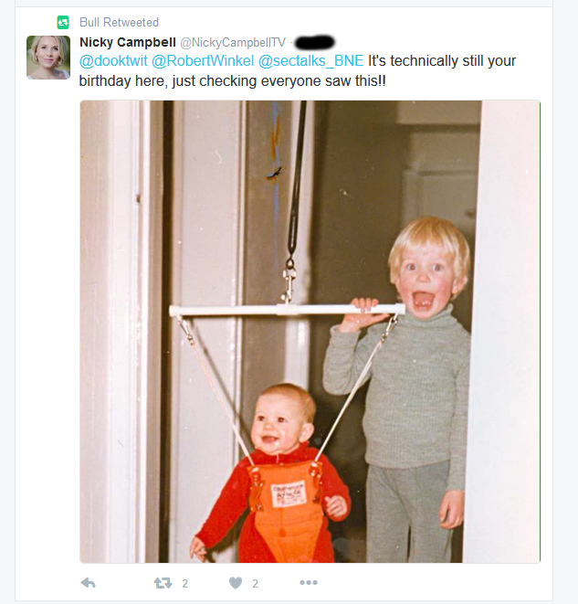
Look for people wishing your mark happy birthday, if you also know their age you have a full date of birth.

Slide 17
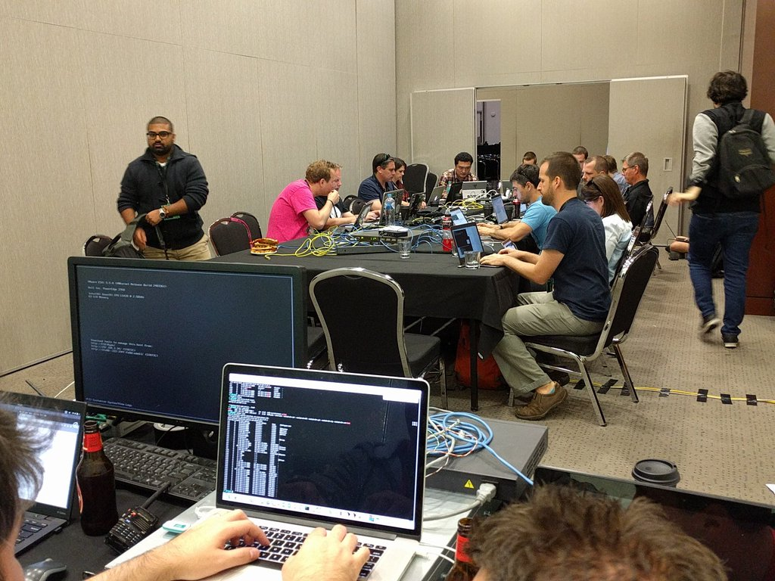
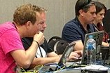
Stickers are like fingerprints

Slide 18
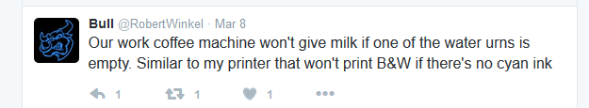
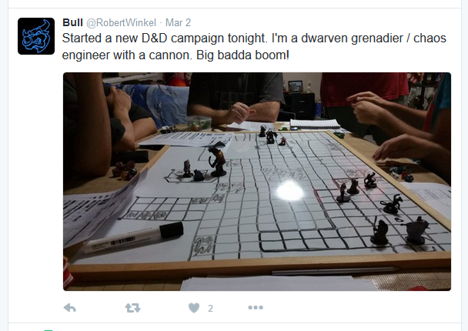
This tweet seems innocuous but has a printer, potential entry point into home network?
Big badda boom...

Slide 19
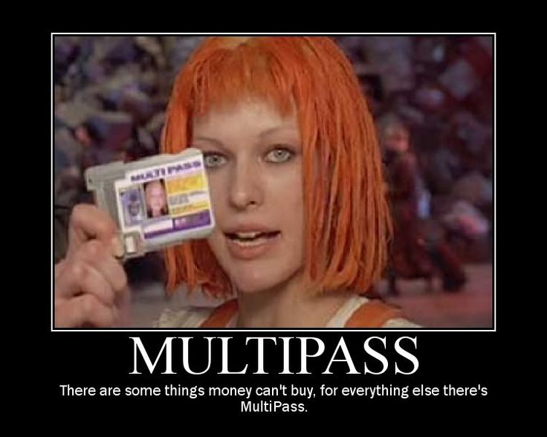
Think he likes The Fifth Element?
Flag!

Slide 20
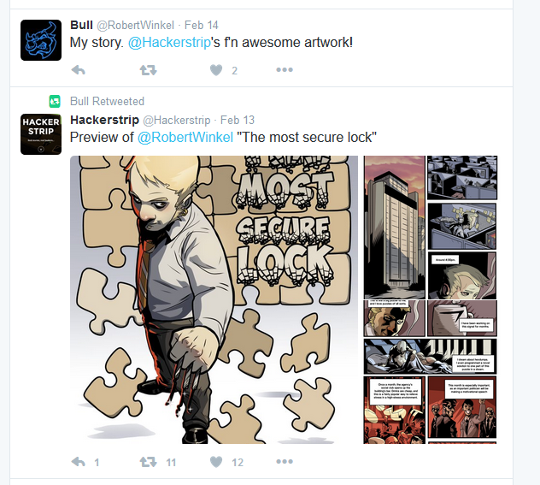
Used this image to confirm correct Facebook account
Other tricks like putting a mobile number into FB search, will come up with account number registered against

Slide 21
Facebook is probably a bit personal to show, but I got...
Suburbs lived in previously
Partner’s facebook which had employment etc
Photos of parter, son and dog
Comment from partner on wedding photo saying was taken x years ago, anniversary is on the xth
Facebook event has year and month of wedding, I have entire wedding anniversary date

Slide 22
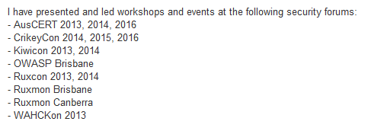
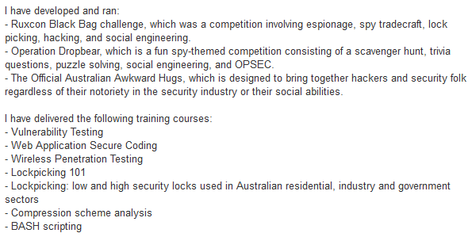
LinkedIn
Flag, flag, flag, flag, flag...

Slide 23
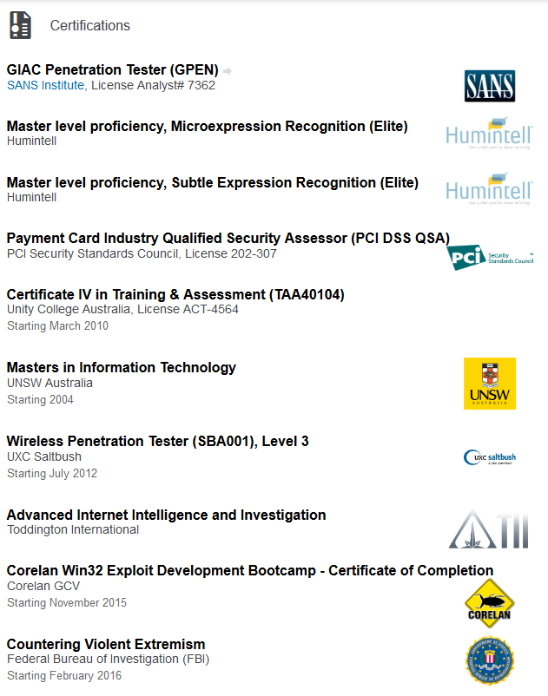
And education...

Slide 24
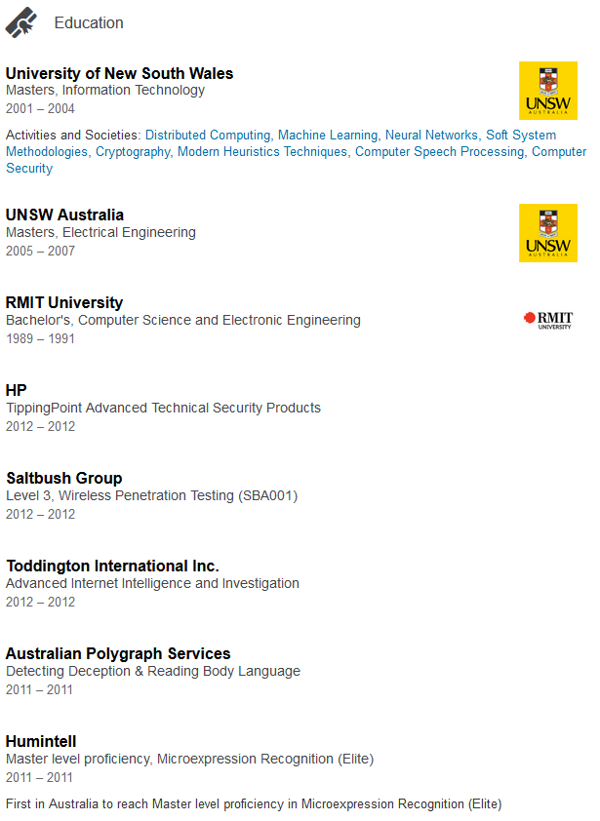
So much education!

Slide 25
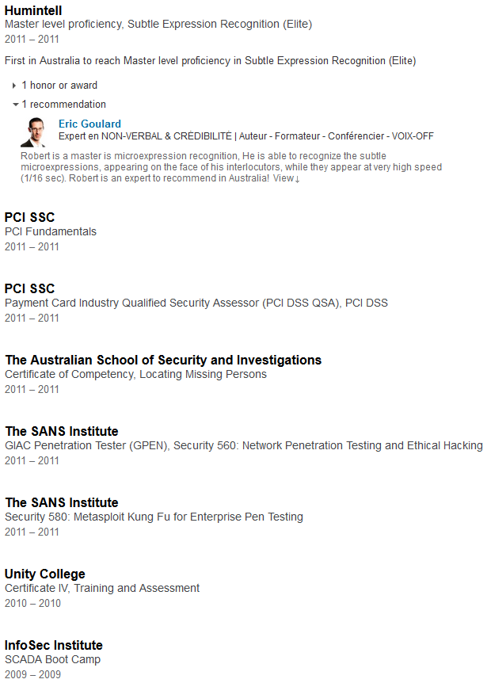
Sooooooooo much education!

Slide 26
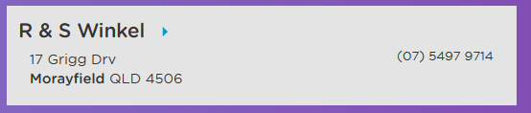
And now things become difficult
Whitepages
Maybe, maybe not...

Slide 27
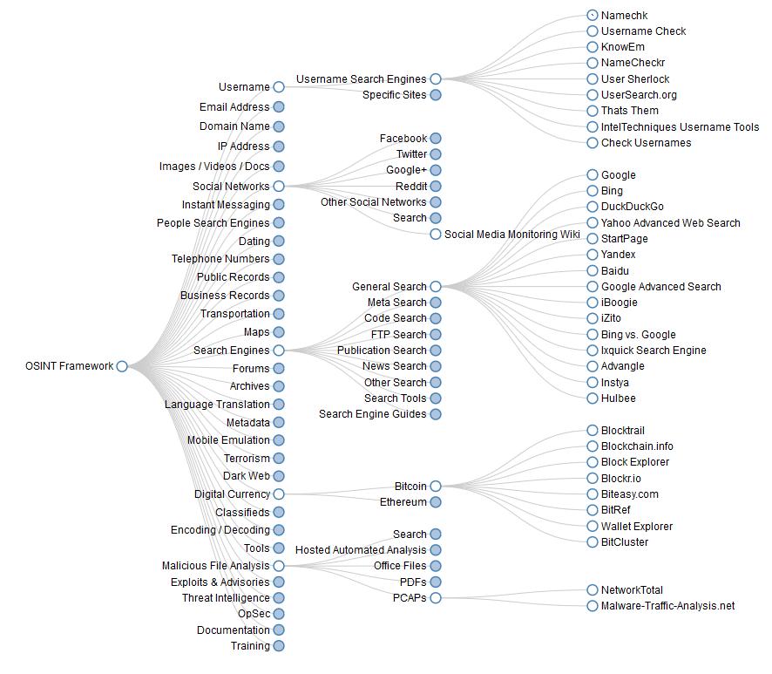
OSINT Framework

Slide 28
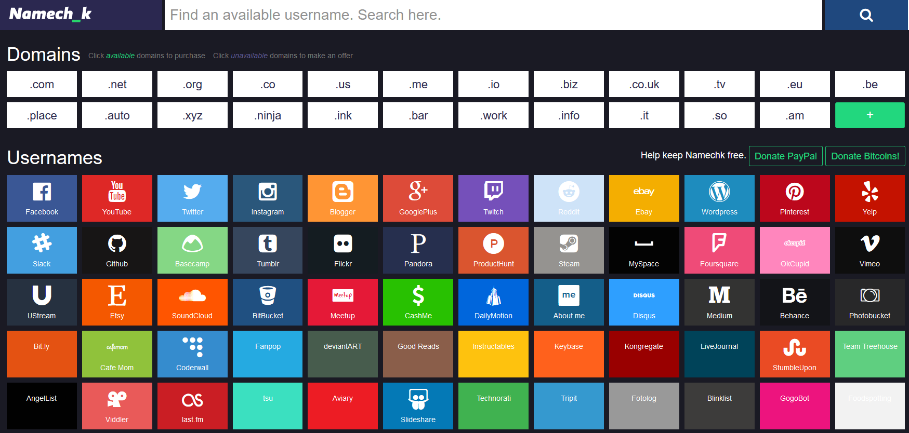
Nameck

Slide 29
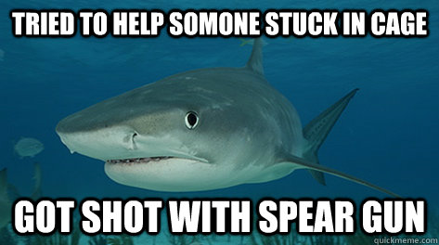
It’s Spear Phishing Time!

Slide 30


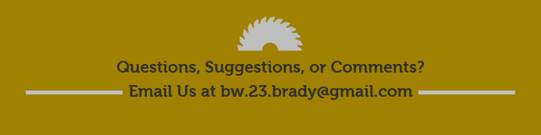
Remember that Kickstarter?

Slide 31

Got that address!

Slide 32

What’s the worst that could happen?

Slide 33
This could happen...

Slide 34
In conclusion
Start with what you can confirm
Use information from confirmed sources to confirm other sources
Piece things together
Pay attention to detail
Use OSINT framework
Think outside the box with spear phishing / pretexting
Hone your emails / practice your calls
Be thorough

Slide 35
Any questions you don’t want to ask in front of the group
kademorton@protonmail.com
@cypath

